Slide 1
RyniXsoft Hybrid Internship Week -2
BY
SWETHASUPRIYA AS
UI/UX DESIGNER

Slide 2
SPRINT -2 Wireframing & Structure
• Create low-fidelity wireframes
• Design core screens:
– Login
– Dashboard
– Task Page
– Admin Panel
• Submit wireframe files

Slide 3
Wireframing & Structure
Content:
Developed low-fidelity wireframes for the Digital Talent Management System (DTMS).
Focused on creating the basic layout and navigation structure.
Designed key screens to visualize the user interaction and workflow.
Objectives:
Plan system layout
Improve usability
Define screen structure

Slide 4
Low-Fidelity Wireframe Design
Low-fidelity wireframes are simple sketches used in the early design stage.
Helps designers test ideas quickly before building the final UI.
Created using basic shapes, placeholders, and simple components.
Link: https://www.figma.com/design/d6sLZG8OQWbccwnlqH7RdW/Untitled?node-id=0-1&t=HGN7cutlmE5FxtgO-1

Slide 5
Core Screen Designs
Login Page
Allows users to securely access the system
Includes username, password, and login button
Dashboard
Displays overview of employee activity and tasks
Provides quick navigation to different modules

Slide 6
Task Page and Admin Panel
Task Page
Shows assigned tasks and deadlines
Allows users to track progress and update task status
Admin Panel
Enables admin to manage employees and assign tasks
Provides system monitoring and control features

Slide 7
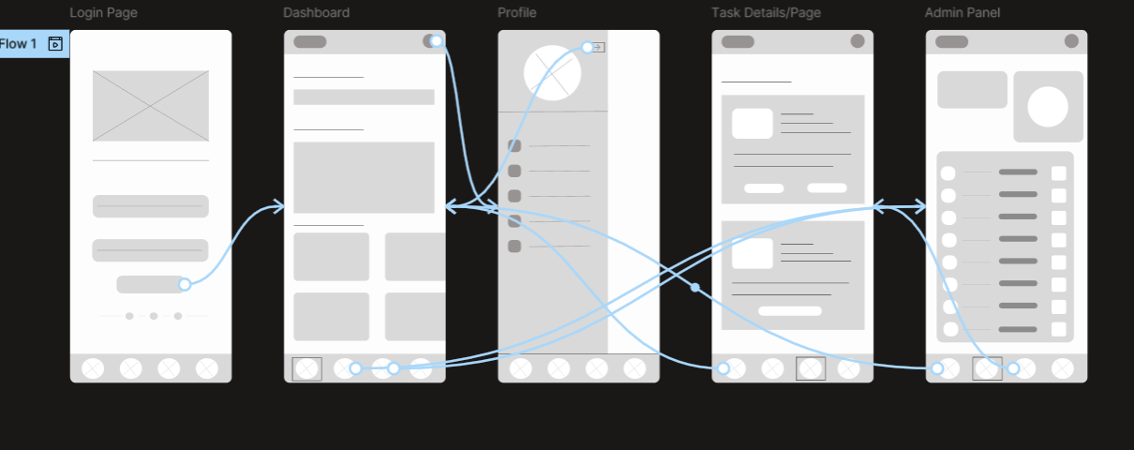

Slide 8
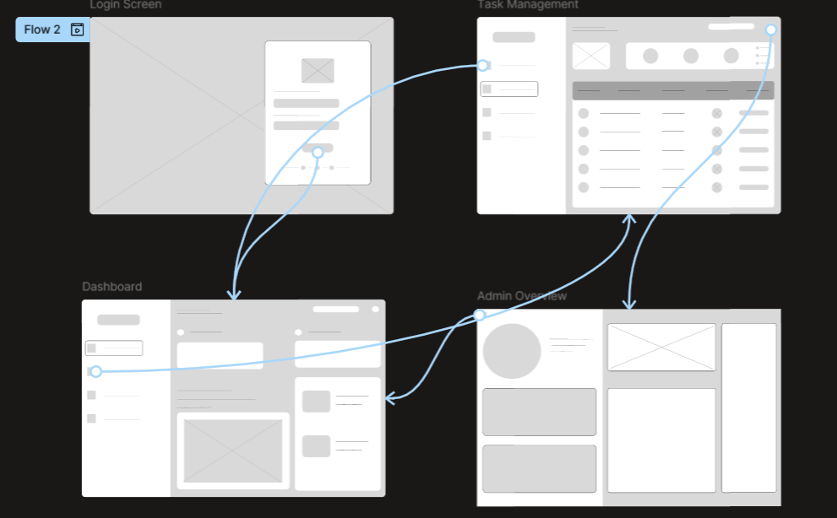

Slide 9
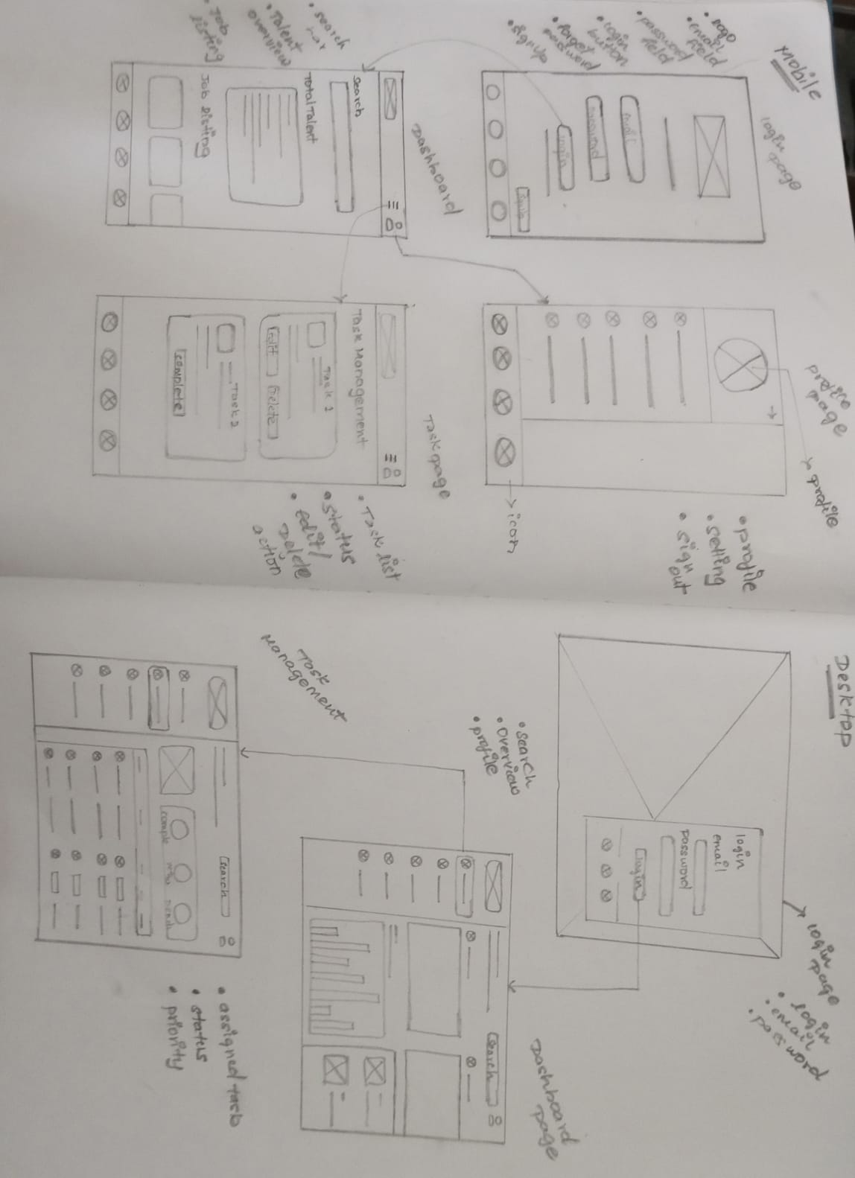

Slide 10


